Slide 1

Hot Threads
Web Technology
Project
Prepared by : 18BCP093, 18BCP079,18BCP083, 18BCP077

Slide 2

About Hot Threads :
It’s a Ahmedabad based Clothing company.
It has wide range of products for Men and women both.
It is run by the professional having 30 years of Experience
in the textile, machinery and dying industry.

Slide 3

Technologies used:
Html
CSS
Javascript
Php
Bootstrap
AJAX
SQL Database

Slide 4
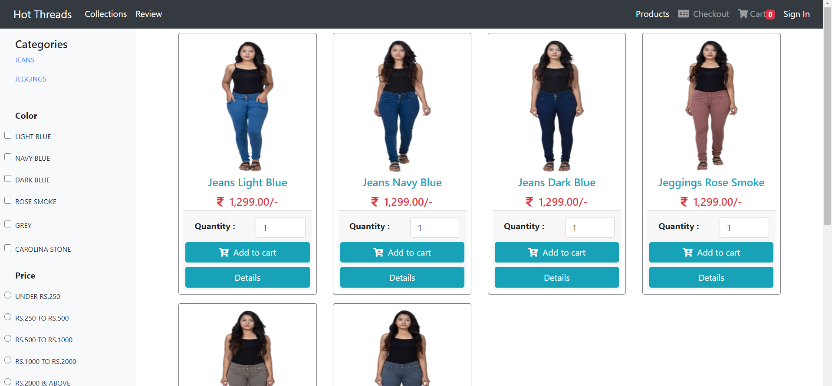
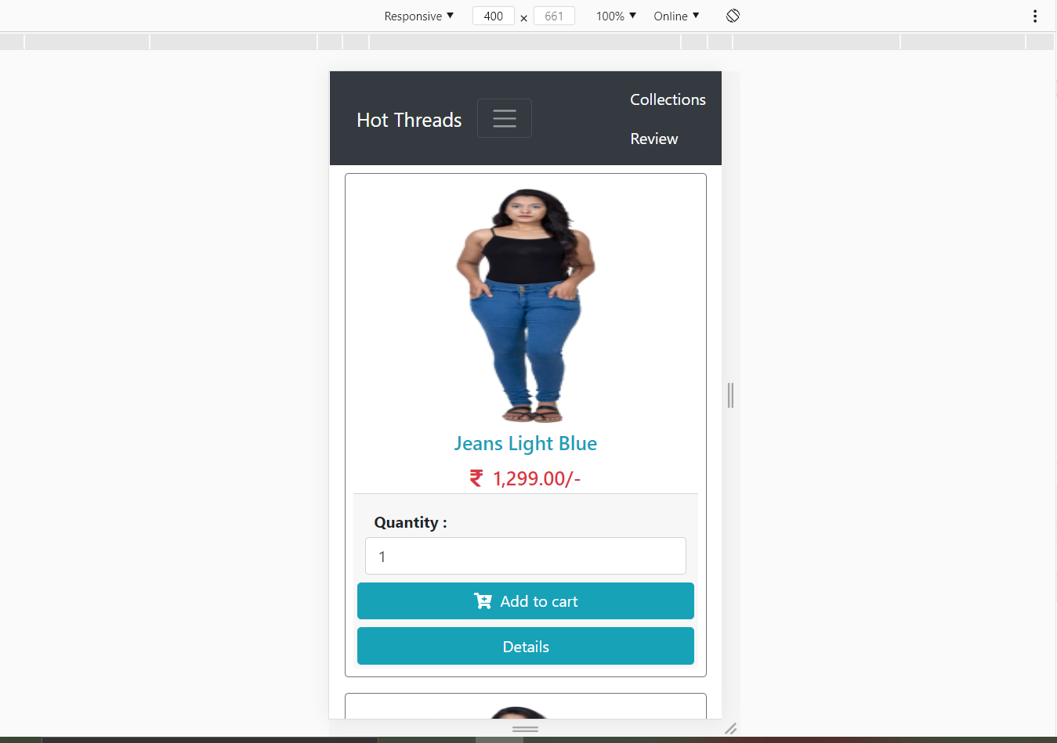
We have made it Responsive for ease of use

Slide 5
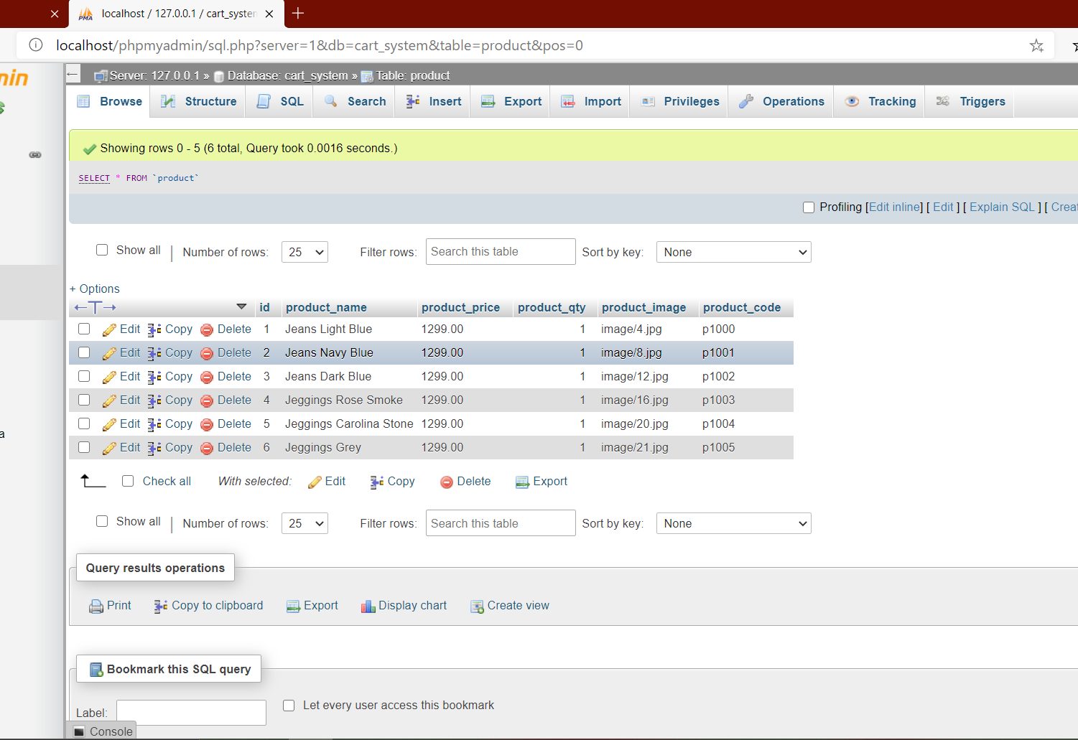
SQL Database
We have used phpMyAdmin database for :
To create data base of products, cart, orders.
To create login system
To create feedback form and storing responses to database.

Slide 6
Why and Where for AJAX?
AJAX method is used in the product display page to enhance the user experience.
Most of the ecommerce website used the AJAX method for infinite scrolling rather than pagination.
As of now the company is not selling much product, but for longer run it enhances the user experience and also saves much of your bandwith.

Slide 7
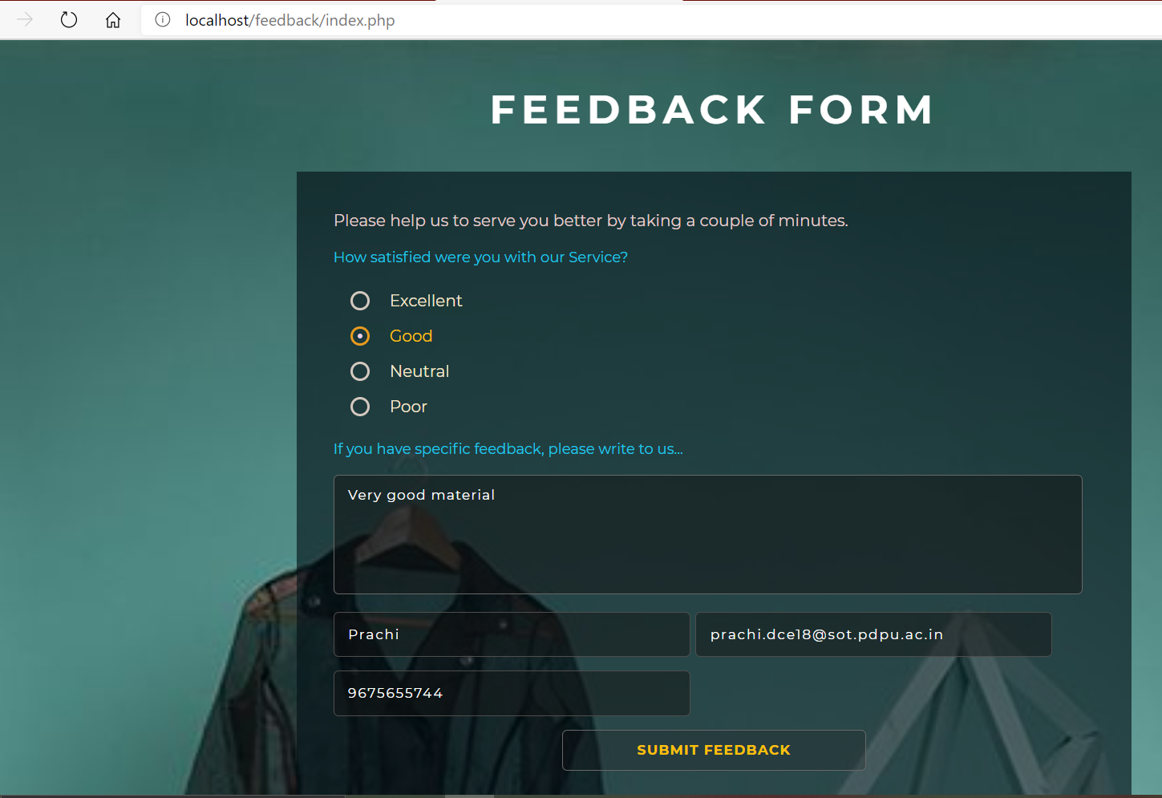
Feedback form
We have created a feedback form using html, CSS and php which will store the feedbacks of customers to our database

Slide 8
Thank You

